Slide 1
Basic Mechanical Engineering

Slide 2
Pure substance
A pure substance which is a homogeneous substance retains its chemical composition even though it undergoes a change in phase during a thermodynamic process.
Water is one of the pure substance, which can exist in the three different phase.

Slide 3
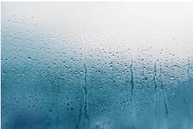
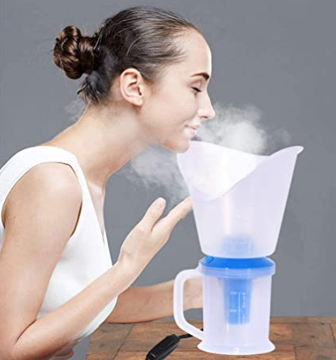
Vapour
It can be defined as that state of the substance in which the evaporation from its liquid state is not complete.
A Vapour consists of a mixture of the pure gaseous form and liquid particles in suspension. Example: Steam contains water particles.
Water Vapour in the air Steam Vapour

Slide 4
Steam
After the complete vapourisation, it exists purely in the gaseous phase as steam.
Vapour do not obeys Boyle’s law and Charle’s law under all conditions of temperature and pressure.

Slide 5
Difference between Steam and Gas
Steam (Vapour) | Gas
It is state of substance in which evaporation is not completed from its liquid state. | It is state in which there is complete vaporization of liquid. It is gaseous state.
It does not obey Boyle’ law, Charle’s law and characteristics gas law. Hence it is not perfect gas. | It obeys all gas laws, hence it is perfect gas.
When the steam is cooled it gets condensed. | It remains in gaseous state at moderate pressure and temperature.
Specific volume of steam is less compared to gases. | Specific volume of gases is more compared to steam.

Slide 6
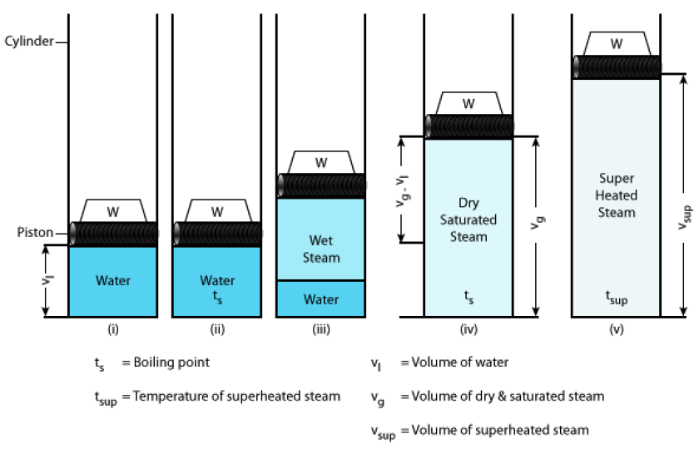
Steam Formation

Slide 7
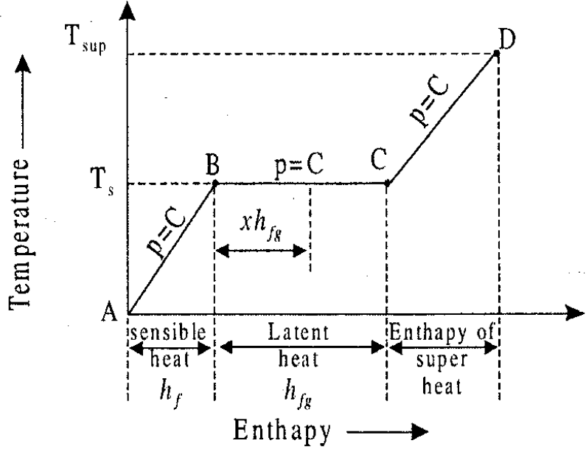
Steam Formation

Slide 8
Steam Formation
The saturation temperature is defined as the temperature at which the water begins to boil at the stated pressure. This condition of water at temperature Ts is represented by the point B on the graph.
The amount of heat required to raise the temperature of 1 kg of water from 0 °C to the saturation temperature Ts °C at a given pressure is known as the sensible heat and denoted by hf. This heat is also called enthalpy of the liquid.
The heat being supplied does not show any rise of temperature but changes water into vapor state (steam) and is called latent heat or hidden heat or enthalpy of evaporation. It is denoted by h_{fg}. If the steam is in contact with water, it is called wet steam.

Slide 9
Steam Formation
If supply of heat to the saturated steam is continued at constant pressure there will be increase in temperature and volume of steam. The temperature of the steam above the saturation temperature at a given pressure is called superheated temperature.
During this process of heating, the dry steam will be heated from its dry state, and the process of heating is called superheating. The steam when superheated is called superheated steam. This superheating is represented by the inclined line CD on the graph.
The amount of heat required to raise the temperature of dry steam from its saturation temperature to any required higher temperature at the given constant pressure is called amount of superheat or enthalpy of superheat. The difference between the superheated temperature and the saturation temperature is known as degree of superheat.

Slide 10
Types of steam
The steam during the steam generation process can exist in three different types:
“Wet steam, dry and saturated steam and superheated steam”

Slide 11
Types of steam (Wet steam)
Both the water molecules and steam coexist to form a two phase mixture, called wet steam.
Dryness fraction of steam is the ratio of the mass of actual dry steam present in a known quantity of wet steam to the total mass of the wet steam.
The quality of the wet steam is specified by the dry fraction which indicates the amount of dry steam present in the given quantity of wet steam and is denoted by x.

Slide 12
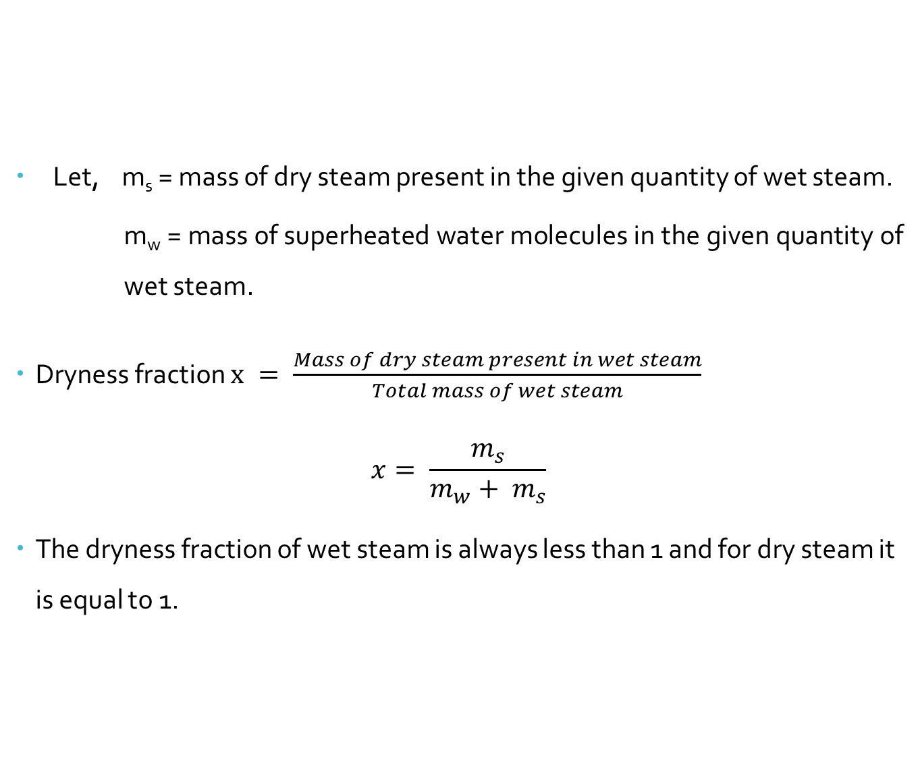
Types of steam (Wet steam)
Let, m_{s} = mass of dry steam present in the given quantity of wet steam.
m_{w} = mass of superheated water molecules in the given quantity of wet steam.
Dryness fraction $x = \frac{Mass of dry steam present in wet steam}{Total mass of wet steam}$
$$x= \frac{m_{s}}{m_{w}+ m_{s}}$$
The dryness fraction of wet steam is always less than 1 and for dry steam it is equal to 1.

Slide 13
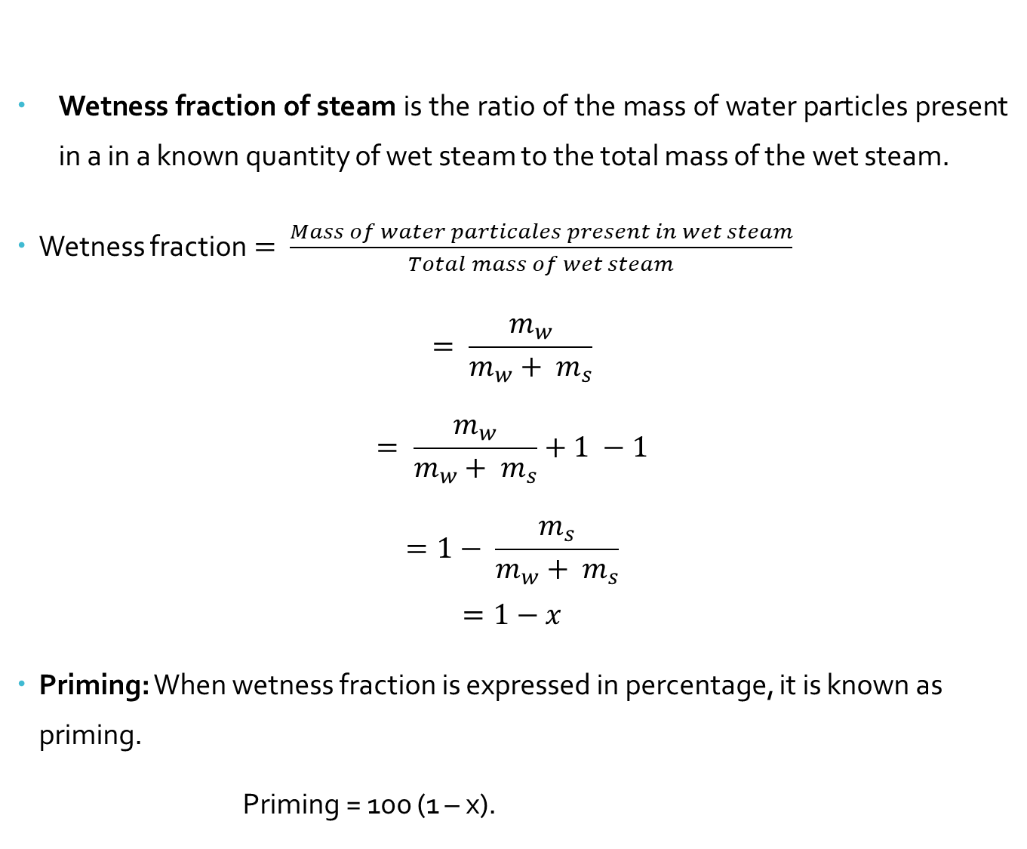
Types of steam (Wet steam)
Wetness fraction of steam is the ratio of the mass of water particles present in a in a known quantity of wet steam to the total mass of the wet steam.
Wetness fraction$= \frac{Mass of water particales present in wet steam}{Total mass of wet steam}$
$$= \frac{m_{w}}{m_{w}+ m_{s}}$$
$$= \frac{m_{w}}{m_{w}+ m_{s}}+1 −1$$
$$=1− \frac{m_{s}}{m_{w}+ m_{s}}$$
$$=1−x$$
Priming: When wetness fraction is expressed in percentage, it is known as priming.
Priming = 100 (1 – x).

Slide 14
Types of steam (Dry saturated steam)
A steam at the saturation temperature corresponding to a given pressure and having no water molecules entrained in it is known as dry saturated steam or dry steam.
Its dryness fraction will be unity because it does not contain any water molecules.

Slide 15
Types of steam (Superheated steam)
When a dry saturated steam is heated further at the given constant pressure, its temperature rises beyond its saturation temperature. The steam in this state is said to be superheated.

Slide 16

Enthalpy of steam
As we know the non flow energy equation,
Heat supplied, $q= ∆ U+W so, q= ∆ U+p dv$
$$∴ q= \left(u_{2} − u_{1}\right)+p \left(v_{2} − v_{1}\right)$$
$$∴ q= \left(u_{2}+p v_{2}\right)− \left(u_{1}+p v_{1}\right)$$
But, specific enthalpy; h = u + p v
$$∴ q= h_{2} − h_{1}= ∆ h$$

Slide 17
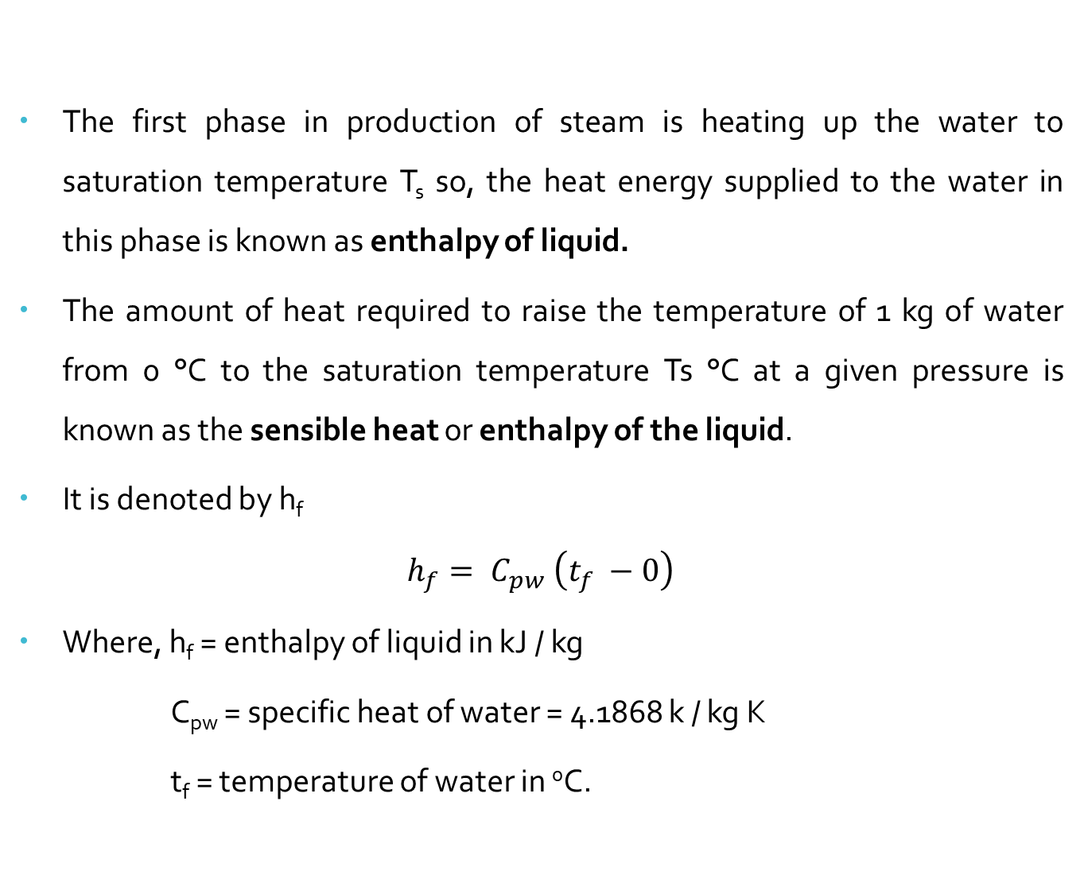
Enthalpy of Liquid
The first phase in production of steam is heating up the water to saturation temperature T_{s} so, the heat energy supplied to the water in this phase is known as enthalpy of liquid.
The amount of heat required to raise the temperature of 1 kg of water from 0 °C to the saturation temperature Ts °C at a given pressure is known as the sensible heat or enthalpy of the liquid.
It is denoted by h_{f}
$$h_{f}= C_{pw} \left(t_{f} −0\right)$$
Where, h_{f} = enthalpy of liquid in kJ / kg
C_{pw} = specific heat of water = 4.1868 k / kg K
t_{f} = temperature of water in ⁰C.

Slide 18

Enthalpy of dry saturated steam
It is defined as the total amount of heat required to convert 1 kg of water into 1 kg of dry saturated steam from its freezing point. It is denoted by hg.
$$h_{g}= h_{f}+ h_{fg}$$

Slide 19

Enthalpy of Wet steam
It is defined as the total amount of heat supplied at a constant pressure to convert 1 kg of water at 0 °C to 1 kg of wet steam at the specified dryness fraction. It is denoted by h.
$$h = h_{f}+x h_{fg}$$

Slide 20

Enthalpy of Superheated steam
It is defined as the total amount of heat required to convert 1 kg of water at 0 °C into 1 kg of superheated steam. It is denoted by h_{sup}.
$$h_{sup} = h_{f}+ h_{fg}+ C_{ps} \left(T_{sup} − T_{sat}\right)$$
$$∴ h_{sup} = h_{g}+ C_{ps} \left(T_{sup} − T_{sat}\right)$$

Slide 21

Degree of superheat
It is defined as the difference between the temperature of superheated steam and dry saturated steam at the given pressure.
$$Degree of superheat = \left(T_{sup} − T_{sat}\right)$$

Slide 22

Amount of superheat
It is defined as the amount of heat added during superheating of steam.
It is also known as heat of superheat.
$$Amount of superheat=C_{ps} \left(T_{sup} − T_{sat}\right)$$

Slide 23
Specific Volume of steam
It is defined as the volume occupied by the unit mass of a substance.
It is expressed in m³ / kg.
The volume of water and steam increases with the increase in temperature

Slide 24
Specific Volume of saturated water
It is defined as the volume occupied by 1 kg of water at the saturation temperature at a given pressure. It is denoted by v_{f} .

Slide 25
Specific Volume of dry saturated steam
It is defined as the volume occupied by 1 kg of dry saturated steam at a given pressure. It is denoted by v_{g} .

Slide 26
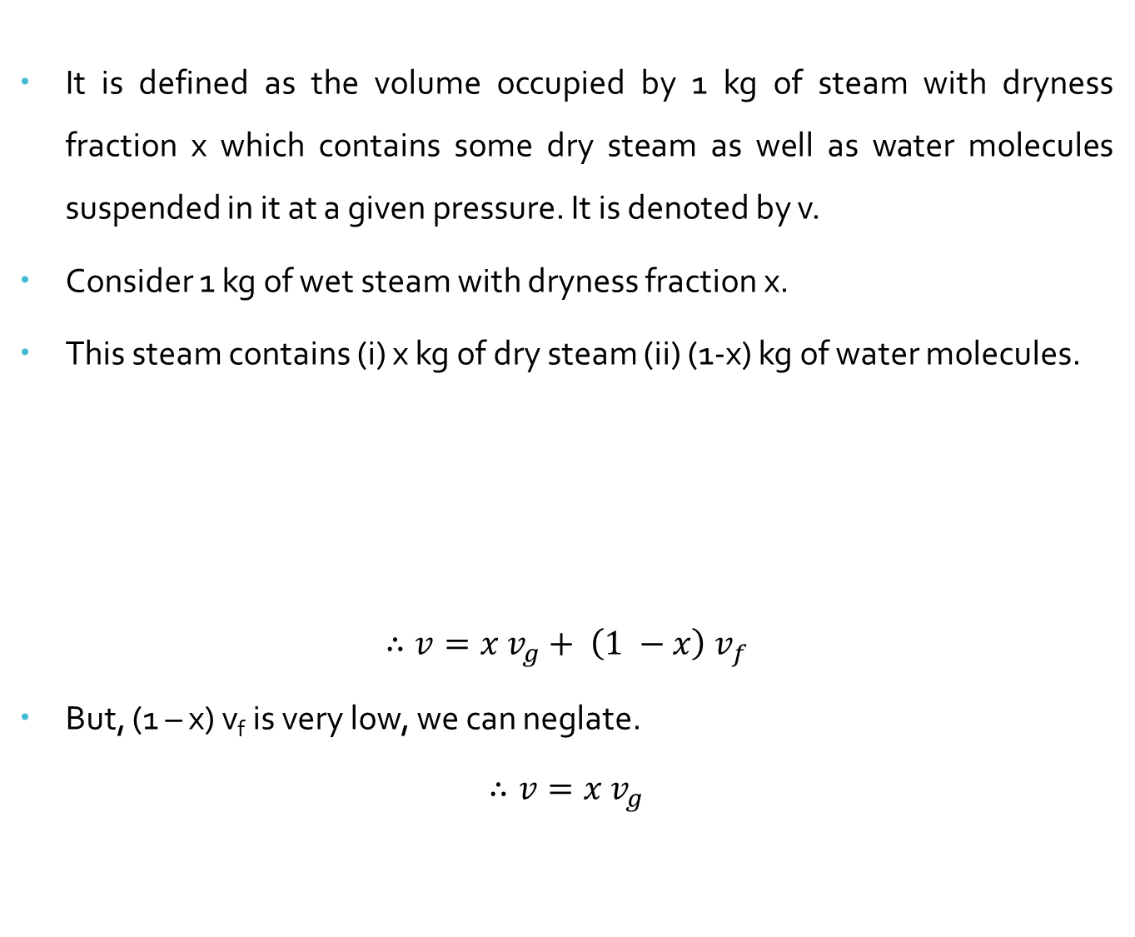
Specific Volume of wet steam
It is defined as the volume occupied by 1 kg of steam with dryness fraction x which contains some dry steam as well as water molecules suspended in it at a given pressure. It is denoted by v.
Consider 1 kg of wet steam with dryness fraction x.
This steam contains (i) x kg of dry steam (ii) (1-x) kg of water molecules.
$$∴v=x v_{g}+ \left(1 −x\right) v_{f}$$
But, (1 – x) v_{f} is very low, we can neglate.
$$∴v=x v_{g}$$
Specific volume of wet steam | = | Volume of dry steam at given pressure | + | Volume of water molecules in mixture

Slide 27

Specific Volume of superheated steam
It is defined as the volume occupied by 1 kg of superheated steam at a given pressure and superheated temperature.
The superheated steam behaves like a perfect gas; so its specific volume is determined approximately applying Charle’s law.
$$\frac{v_{g}}{T_{s}}= \frac{v_{sup}}{T_{sup}}$$
$$∴ v_{sup}=\frac{{T_{sup} v}_{g}}{T_{s}}$$

Slide 28
Internal energy of steam
Internal energy is defined as the difference between the enthalpy of steam and external work of evaporation.
Internal energy of dry steam: u_{g} = h_{g} – p v_{g}
Internal energy of wet steam: u = h_{f} + x h_{fg} – p x v_{g}
Internal energy of superheated steam: u_{sup} = h_{sup} – p v_{sup}

Slide 29
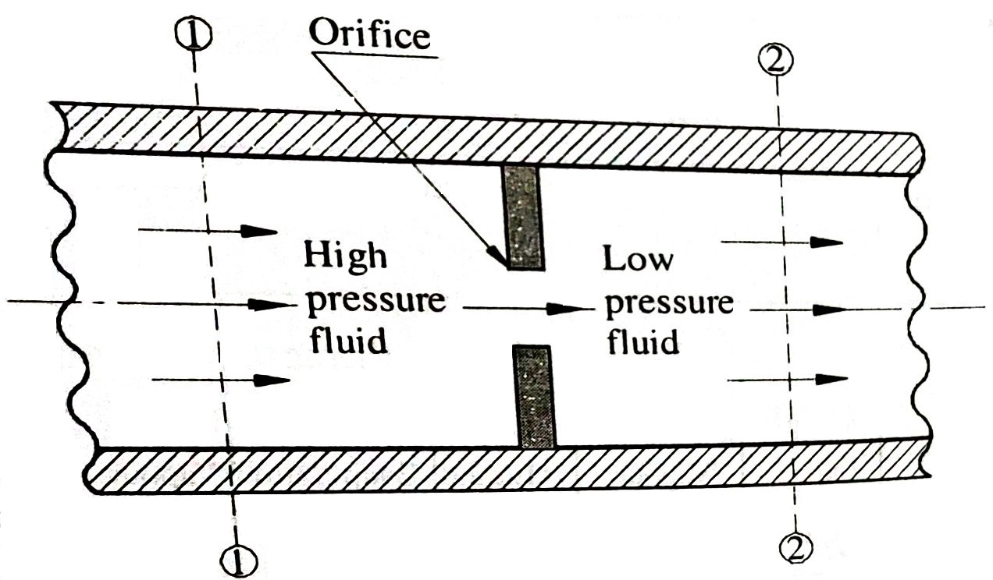
Throttling Process
Throttling is the type of expansion process, in which steam passes through a narrow passage and expands with a full pressure without doing any external work.
In this process there is no exchange of heat similar to adiabatic process.
During this process, the enthalpy remains constant, so this process is also known as constant enthalpy process.

Slide 30
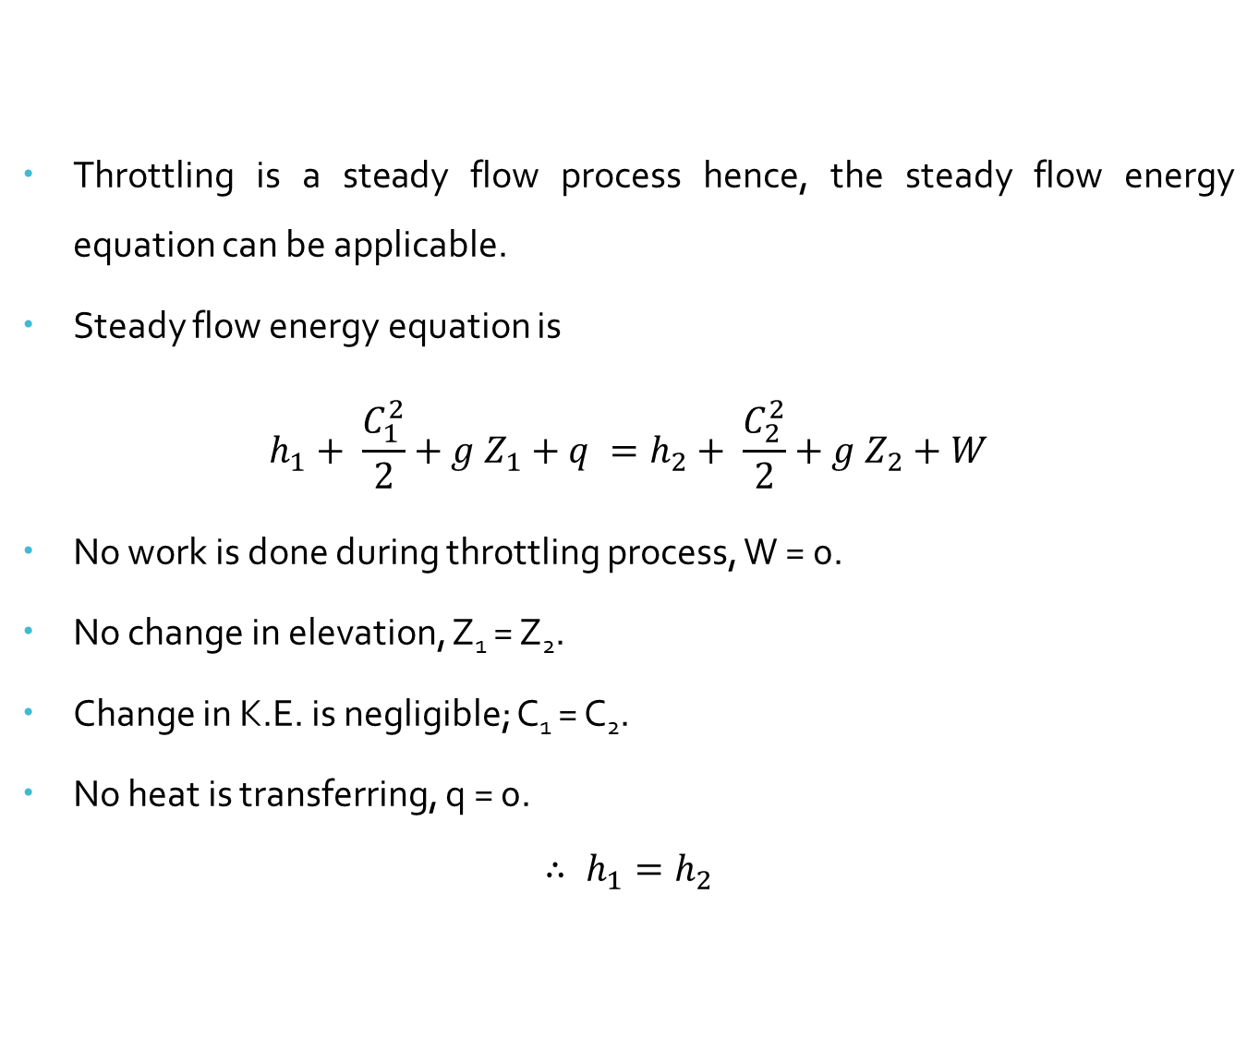
Throttling Process
Throttling is a steady flow process hence, the steady flow energy equation can be applicable.
Steady flow energy equation is
$$h_{1}+ \frac{C_{1}^{2}}{2}+g Z_{1}+q =h_{2}+ \frac{C_{2}^{2}}{2}+g Z_{2}+W$$
No work is done during throttling process, W = 0.
No change in elevation, Z₁ = Z₂.
Change in K.E. is negligible; C₁ = C₂.
No heat is transferring, q = 0.
$$∴ h_{1}=h_{2}$$

Slide 31
Measurement of dryness fraction
The dryness fraction of steam can be measured experimentally.
Calorimeters are used for measurement of dryness fraction of steam.
There are four methods of determining the dryness fraction of steam.
Bucket or Barrel calorimeter
Throttling calorimeter
Separating calorimeter
Combined separating and throttling calorimeter

Slide 32
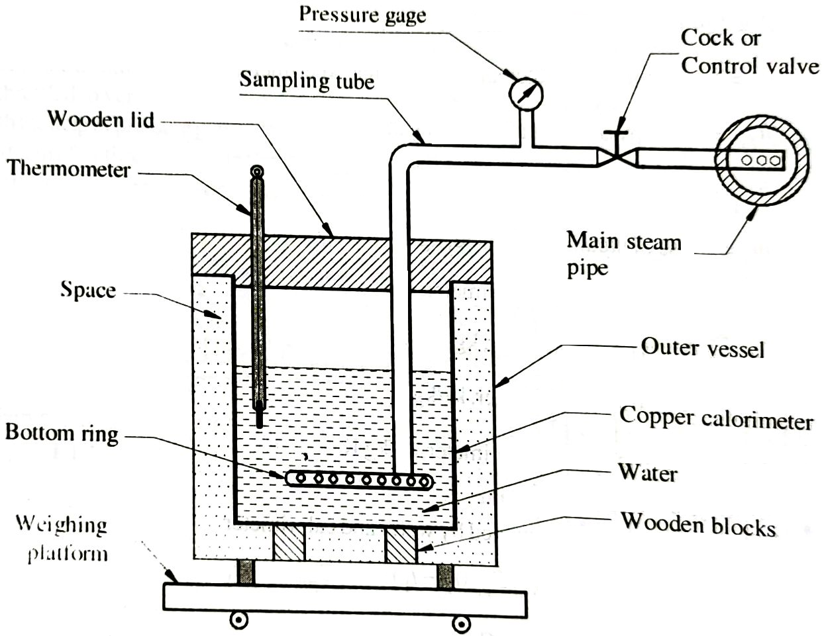
Bucket or Barrel calorimeter

Slide 33
Bucket or Barrel calorimeter
Heat Loss by the steam = Heat gained by water and calorimeter
But, is called Water Equivalent of Calorimeter.

Slide 34
Bucket or Barrel calorimeter
Limitations:
This method is not accurate.
Accuracy decreases as temperature difference (t₂ – t₁) increases because losses are more at higher temperature difference.

Slide 35
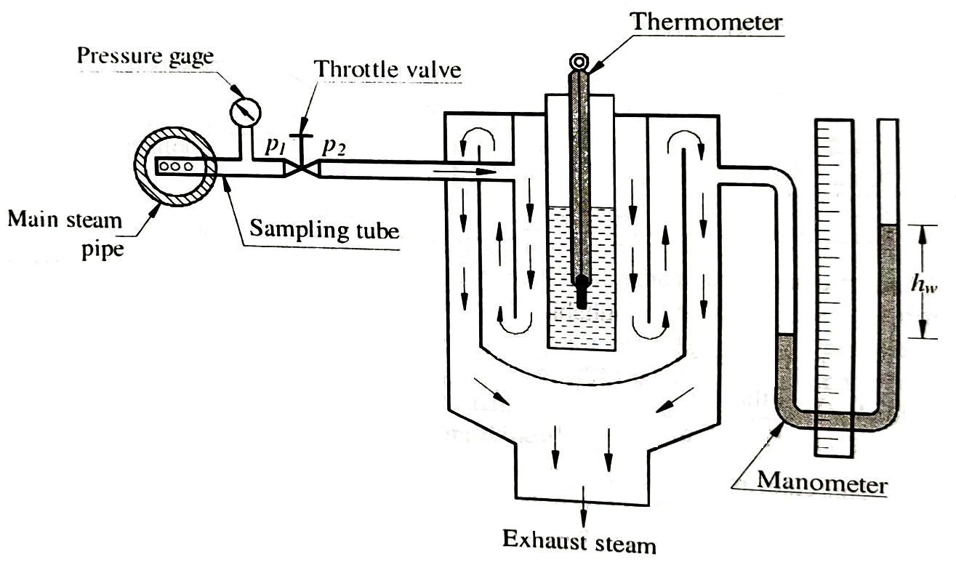
Throttling calorimeter

Slide 36
Throttling calorimeter
Enthalpy before throttling = Enthalpy after throttling
Enthalpy at p₁ = Enthalpy at p₂

Slide 37
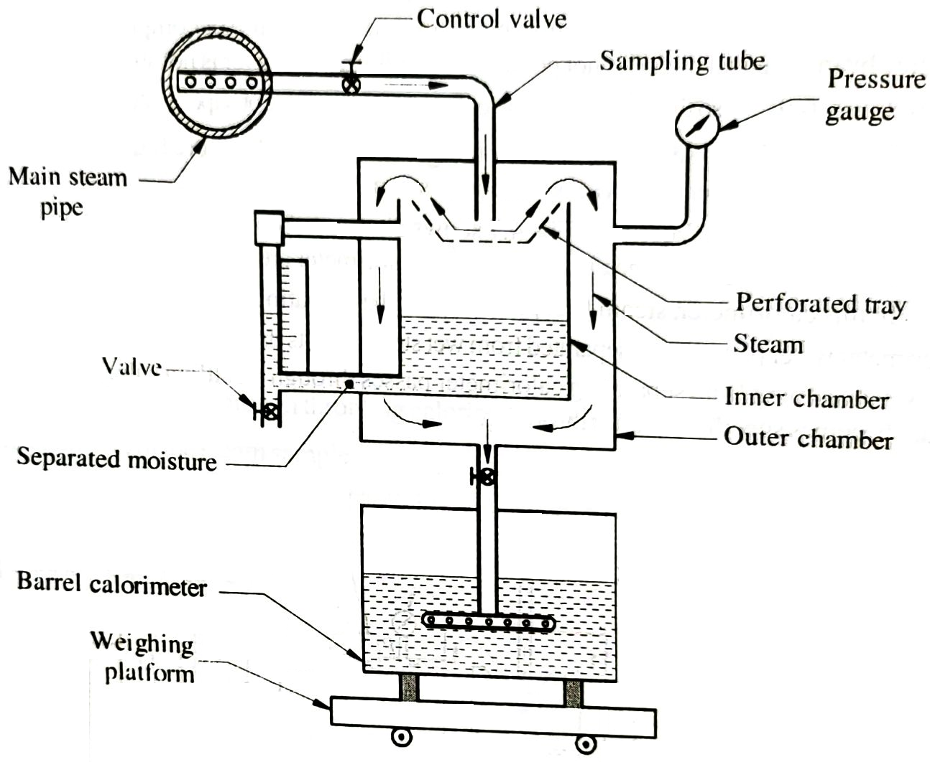
Separating calorimeter

Slide 38
Separating calorimeter
Where, m_{s} = mass steam condensed in barrel calorimeter
m_{w} = mass of water collected in inner chamber
x = dryness fraction

Slide 39
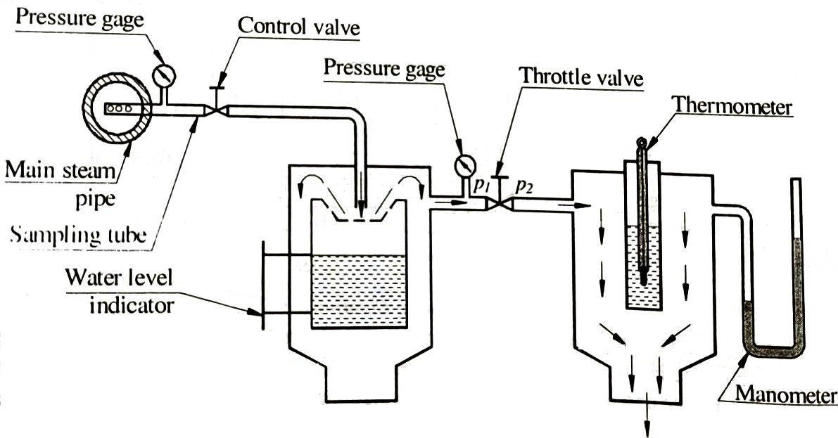
Combined separating and throttling calorimeter

Slide 40
Combined separating and throttling calorimeter

Slide 41
Steam Table

Slide 42
Numerical 1
Find the enthalpy of 1 kg of steam at 12 bar when (i) steam is dry saturated, (ii) steam is 22% wet and, (iii) superheated to 250 ⁰C. Use the steam table. Assume the specific heat of the superheated steam as 2.1 kJ/kg.K.
Given data:
m = 1 kg, p = 12 bar = 12 x 10⁵ N/m²,
Steam is 22% wet, hence wetness fraction= 0.22,
dryness fraction, x = 1 – 0.22 = 0.78, T_{sup} = 250º C,
Enthalpy of steam, h = ?

Slide 43
Numerical 1
From the steam tables at 12 bar, the following values are noted.
Ts = 188 ºC,
hf = 798.43 kJ/kg
hfg = 1984.3 kJ/kg
(i) Enthalpy of dry saturated steam:
h = hf + hfg = 798.43 + 1984.3 = 2782.73 kJ/kg
(ii) Enthalpy of wet steam,
h = hf + (x) x hfg = 798.43 + (0.78 x 1984.3) = 2346.18 kJ/kg
(iii) Enthalpy of superheated steam,
h = hf + hfg + Cps (Tsup - Ts)
h = 798.43 + 1984.3 + 2.1 (250 – 188) = 2912.93 kJ/kg

Slide 44
Numerical 2
Determine enthalpy & internal energy of 1 kg of steam at pressure 12 bar when (i) dryness fraction of steam is 0.8 (ii) steam is dry & saturated (iii) steam is superheated to 280°C. Take C_{ps} = 2.1KJ/kg K.
Given data:
P = 12 bar, x= 0.8, T_{sup} = 280⁰C, C_{ps} = 2.1 KJ/kg, h= ?, u = ?, h_{g} = ?, h_{sup} = ?

Slide 45
Numerical 2
From the steam tables at 12 bar, the following values are noted.
T_{s} = 187.96 ºC,
h_{f} = 798.43 kJ/kg
h_{fg} = 1984.3 kJ/kg
v_{g} = 0.1632 m³/kg

Slide 46
Numerical 2

Slide 47
Numerical 3
Determine enthalpy & internal energy of 1 kg of steam at pressure 15 bar when (i) dryness fraction of steam is 0.9 (ii) steam is superheated to 400 °C. Take C_{ps} = 2.1KJ/kg K.
Given data:
P = 15 bar, x= 0.9, T_{sup} = 400 ⁰C, C_{ps} = 2.1 KJ/kg, h= ?, u_{sup} = ?, h_{sup} = ?, h = ?, u = ?

Slide 48
Numerical 3
From the steam tables at 15 bar, the following values are noted.
T_{s} = 198.3 ºC,
h_{f} = 844.7 kJ/kg
h_{fg} = 1945.2 kJ/kg
v_{g} = 0.1317 m³/kg

Slide 49
Numerical 4
Determine amount of heat is required to produce 7 kg of steam at a pressure of 6 bar and temperature of 250 ºC from water at 35 ºC, take Cps = 2.1 kJ/kg K.
Given data:
m = 7 kg, p = 6 bar = 6 x 10⁵ N/m², Temp. of steam = 250 ⁰C, Temp. of water = 35 ⁰C, C_{ps} = 2.1 kJ / kg K

Slide 50
Numerical 4
From the steam tables at 5 bar, the following values are noted.
T_{s} = 158.8 ºC,
h_{f} = 670.4 kJ/kg
h_{fg} = 2085 kJ/kg

Slide 51
Numerical 4

Slide 52
Numerical 5
What amount of heat is required to produce 5 kg of steam at a pressure of 5 bar and temperature of 250 ºC from water at 30 ºC, take Cps = 2.1 kJ/kg K.
Given data:
m = 5 kg, p = 5 bar = 5 x 10⁵ N/m², Temp. of steam = 250 ⁰C, Temp. of water = 30 ⁰C, C_{ps} = 2.1 kJ / kg K

Slide 53
Numerical 5
From the steam tables at 5 bar, the following values are noted.
T_{s} = 151.84 ºC,
h_{f} = 640.1 kJ/kg
h_{fg} = 2107.4 kJ/kg

Slide 54
Numerical 6
Determine the mass of 0.15 m³ of wet steam at a pressure of 4 bar and dryness fraction 0.8. Also calculate the heat of 1 m³ of steam.
Given data:
V = total volume = 0.15 m³, p = 4 bar, x = 0.8, m_{s} = ?

Slide 55
Numerical 6
From the steam tables at 4 bar, the following values are noted.
T_{s} = 143.6 ºC,
h_{f} = 604.7 kJ/kg
h_{fg} = 2133 kJ/kg
h_{g} = 2737.6 kJ/kg
v_{f} = 0.001084 m³/kg
v_{g} = 0.462 m³/kg

Slide 56
Numerical 6

Slide 57
Numerical 7
Calculate internal energy per kg of superheated steam at 10 bar and temperature of 300 ºC. Find also change in internal energy if this steam is expanded to 1.4 bar and dryness fraction 0.8. Take C_{ps} = 2.1 kJ/kg.
Given data:
p₁ = 10 bar, T₁ = 300 ºC , p₂ = 1.4 bar, x₂ = 0.8, u1 = ?, u1 – u2 = ?

Slide 58
Numerical 7
From the steam tables at 10 bar, the following values are noted.
T_{s} = 179.9 ºC,
h_{f} = 762.6 kJ/kg
h_{fg} = 2013.6 kJ/kg
h_{g} = 2776.2 kJ/kg
v_{f} = 0.001127 m³/kg
v_{g} = 0.194 m³/kg

Slide 59
Numerical 7

Slide 60
Numerical 8
Determine the quality of steam for the following cases:
(i) p = 10 bar, v = 0.180 m³/kg, (ii) p = 10 bar, t = 200º C, (iii) p = 25 bar, h = 2750 kJ/kg

Slide 61
Numerical 8

Slide 62
Numerical 9
During the test with separating calorimeter, amount of moisture collected in a given period is two kg and mass of steam leaving the calorimeter is 15 kg. Calculate dryness fraction of steam.
Given data:
m_{w} = 2 kg, m_{s} = 15 kg, x = ?

Slide 63
Numerical 9

